Slide 21
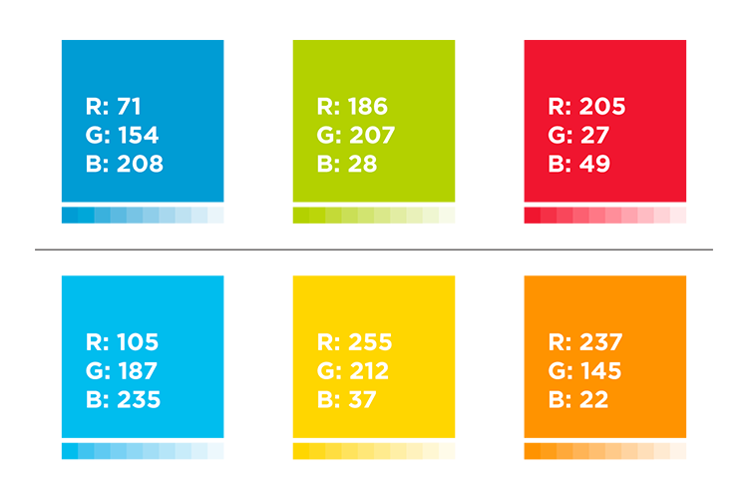
Colors
This template is set up to use the RGB brand colors plus BLACK for text.
I didn’t use this lighter blue because on screen it looks too close to the main blue. I suggest either making it lighter or making the main blue darker if wanting to use both.

Slide 22
Font
Century Gothic
This is a good font because all computers will recognize it.
If using a designer font, you’ll have to make sure all users have the font installed on their computer.

